Slide 1
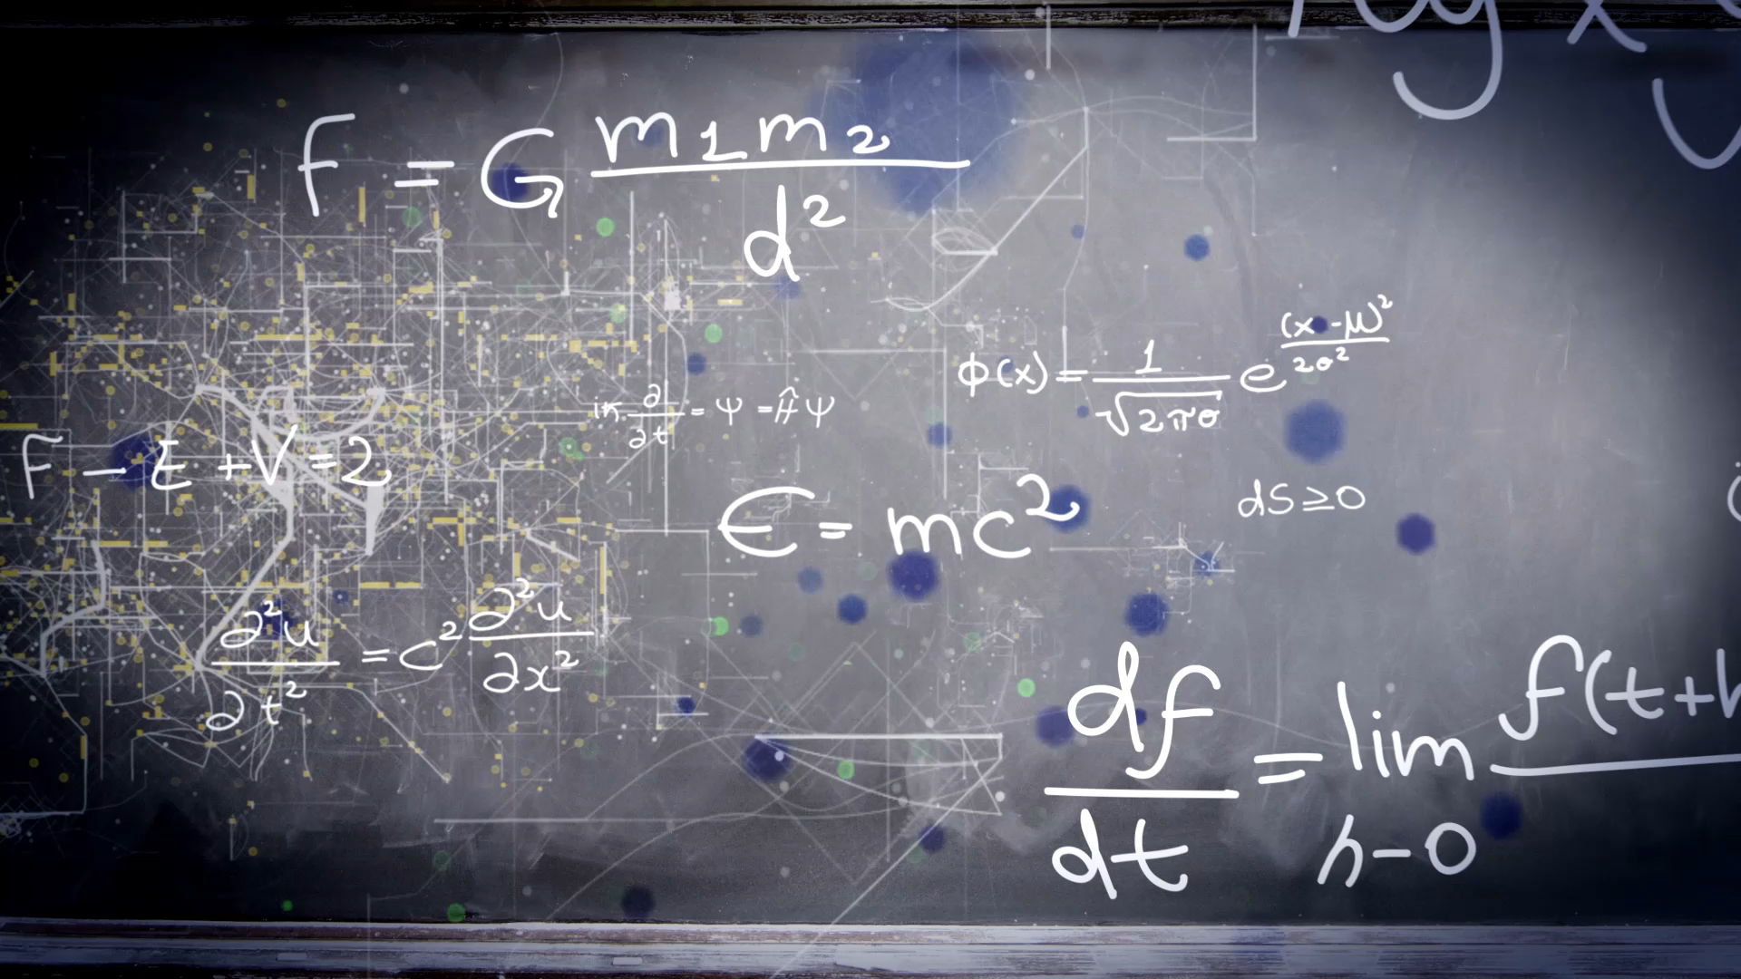

SMALL TALK ABOUT: MACHINE LEARNING
By Tuyen Nguyen
AI club, Southeast Missouri State University

Slide 2

WHAT IS MACHINE LEARNING?

Slide 3

How do we as human learn?

Slide 4
How do we as human learn?
From observation
From experience
From school
From books
=> Regardless of the form, all of them are information and data that we collect to gain knowledge and insight

Slide 5
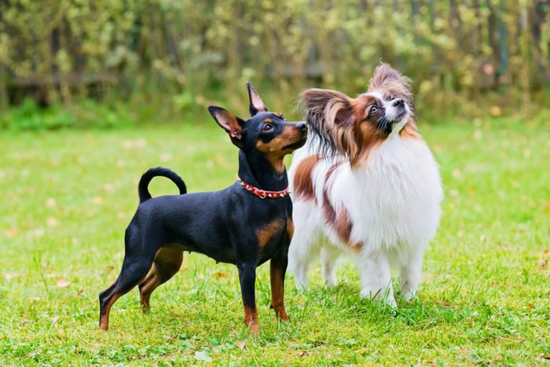
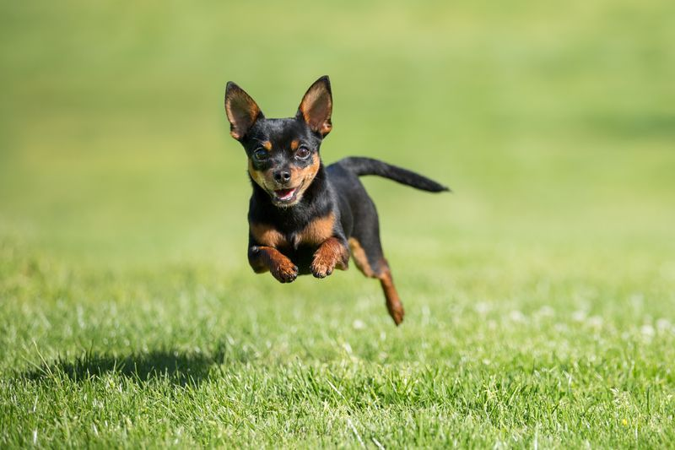

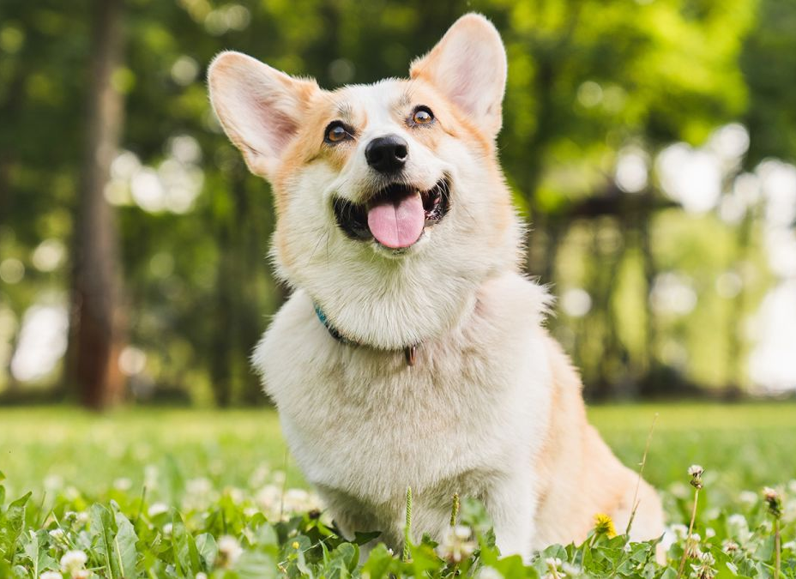
How do we know a dog is a dog
Notes:
Saw a lot of dogs
When you walked on the street, you saw a cute dog, and your parent taught you that that was a dog.
Or you learned from your teacher at the garden school.
Or you watched a cattoon movie where there is a dog character.
From time to time, your brain unconsciously realize some common character of a dog.
The next time, you see another type of dog, completely new, have some very special characteristics, you still realize that dog because it also shares certain characteristics with other dogs and these characteristics differentiate dogs with other kinds of animals

Slide 6
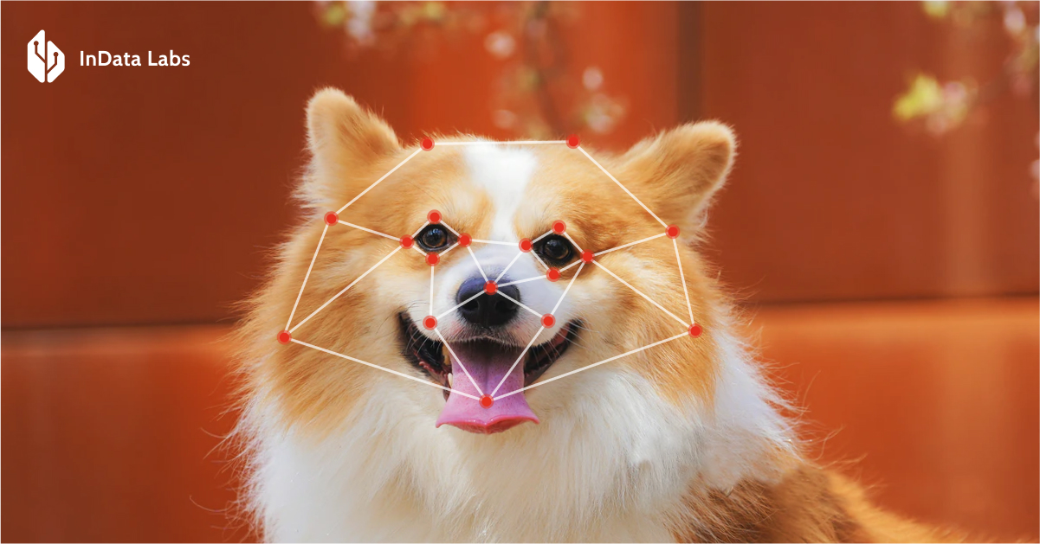
Machine learning VS Human Learning
Human learn to recognize a dog through their experience and observations <>
Image recognition in machine learning using thousands or images to improve predictive model
Image recognition

Slide 7
Human can learn because we have nervous system (brain)
Machine learning can learn because of development in technology (computing power, memory and storage) and science.

Slide 8
Why do we need machine learning?
Big data is available
Human desires to gain more insight, realize the pattern of a difficult task (e.g. detect spam)
But human has limited capability
Abundant computer resource
Mathematician comes up with a lot of good predictive model
Notes:
As the data volume surpasses human ability to make sense or derive rules, we need an automated system that can learn and realize pattern from data.

Slide 9
USING DATA to ANSWER QUESTIONS
What is machine learning?

Slide 10
USING DATA to ANSWER QUESTIONS
Using Data is a training process using training data to produce predictive model
Answer questions is a prediction process using created predictive model to produce answers for given set of inputs.

Slide 11
Data -> Training -> create and fine tune our predictive model
-> Serve prediction -> answer questions

Slide 12
7 steps of machine learning
The 7 steps of machine learning - YouTube

Slide 13
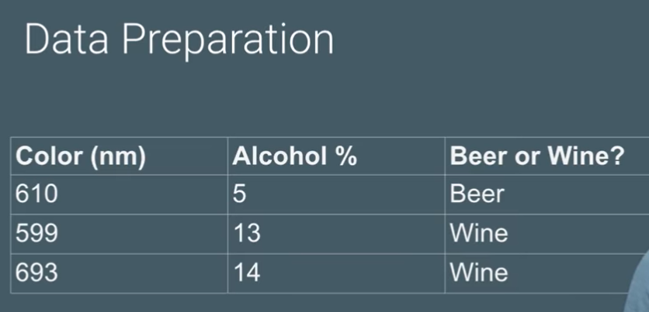
Step 1: Gathering trainning data
Gathering and labeling the data

Slide 14
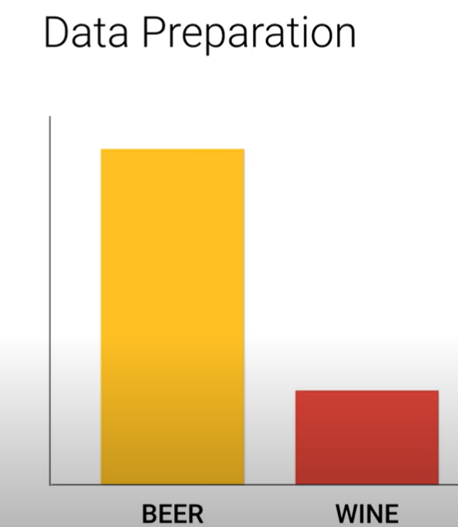
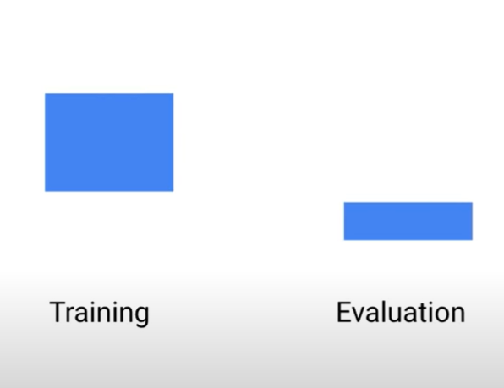
Step 2: Data preparation
randomize the data
visualize data, relationship between data
see if unbalanced/ biased trainning data
split data into: trainning and testing (80% trainning -20% testing

Slide 15
Step 3. Choosing a model
model for numerical
- model for text
model for image
In our example, we use a linear model called logistics model with two features (inputs) and one output.
Features are color and alcohol percentages
Output is whether the product is beer or wine

Slide 16
Step 4. training
using data to improve the model
Epoch 1: training data -> model (w, b)-> prediction -> Update (w,b)-> trainning data -> model ....
Epoch 2: training data -> model ...
each training step is called an epoch

Slide 17
Step 5. Evaluation
how the model perform with the testing data

Slide 18
Step 6. Improve model: parameter tuning
parameters include:
- number of epochs: number of times for the model to go over the trainning dataset again and again
- learning rate: how fast we change the parameters (w,b)

Slide 19
Step 7. Prediction: use model to answer question

Slide 20
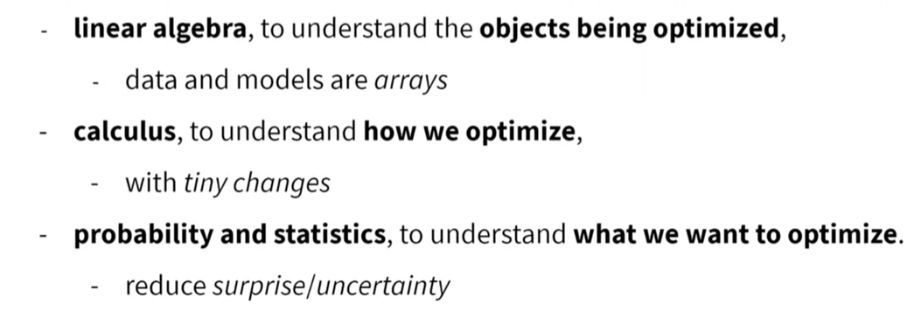
Math behind Machine learning

Slide 21
What we will do and learn in the next couple of weeks
Install GitHub, learn to use basic GitHub commands
Learn Simple Machine learning model, called Linear Regression
How Optimization (using Calculus) works?
Probability and Statistics involved in Linear Regression. How to interpret the model summary?
Using Python libraries: Pandas (data cleaning), matplotlib (data visualization), statsmodel (machine learning)

Slide 22


